Slide 1





CITZ
Digital Identity in British Columbia
BC Services Card

Slide 2
Topics
Where we started and where we are
What we have: BC’s Identity Assets
How it works: Online Activation
Video Orientation
Unlocking the Value: Serving BC Citizens and Businesses
Our Results

Slide 3

B.C.’s Vision
For citizens to safely and securely access multiple government services, both in-person and online, through the creation of a security-enhanced photo ID.

Slide 4

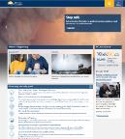
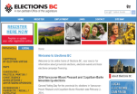
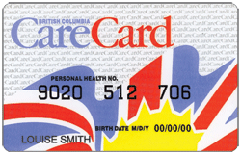
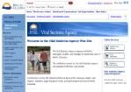
Where We Started: BC's Trigger Event
Citizens Services - Corporate Enabler: Access to Services
Ministry of Health
CareCard replacement and Medical Services Plan
re-enrollment
Replacement
9 million cards issued and active for 4.5 million people
Most costly and important service government provides

Slide 5
What we learned: Why are Driver’s License processes so robust?
Why are fraudulent passports and licenses available from black market?
Staff trained in fraud detection – documents, but also, how people present and interact
Security features of the plastic itself
Security and control of card manufacturing – treated like printing money, secure dedicated facility, specialized machines etc..
Facial recognition on digital photos to catch account take over and fraud
Manual verification of each card by experienced staff – flag anomalies and suspicion when photos, names, addresses etc do not "look right"

Slide 6

Building Blocks
Legislation and Regulations
Partnerships
Governance and Oversight
Service Delivery
Public Consultation and Communications
Technology

Slide 7


Where We Are
3 partners, 1 card
CareCard replacement as evidence of enrolment in Medical Services Plan
In-person access to services
Online access to services
Built on card chip technology
Health
CareCard replacement and
Medical Services Plan Renewal
Citizens Services
Trusted identity to transform services
ICBC
Drivers License
Gov’t Issued ID
Card Production
High Assurance Credential
in person verification tied to
foundational identity documents

Slide 8
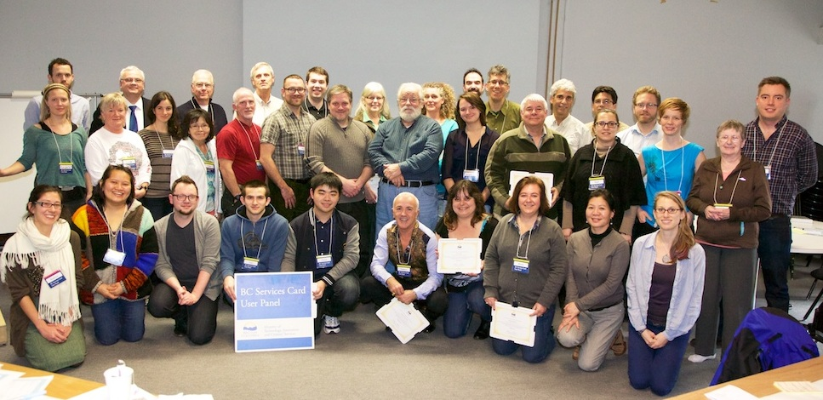
Building Blocks: Public Consultation

Slide 9
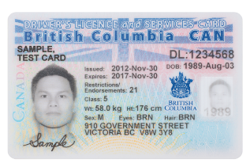
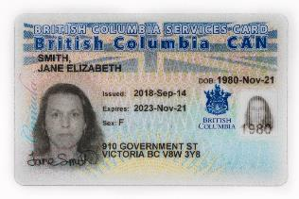
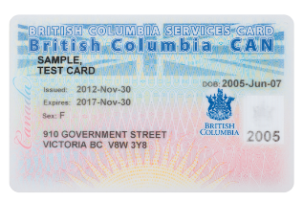
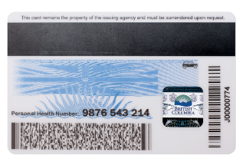
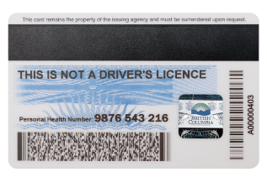
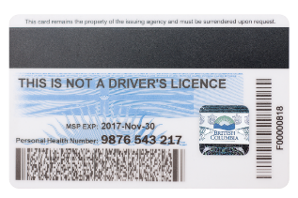
The BC Services Card: Three Types
Combo Card
Photo Card
Non-Photo Card

Slide 10
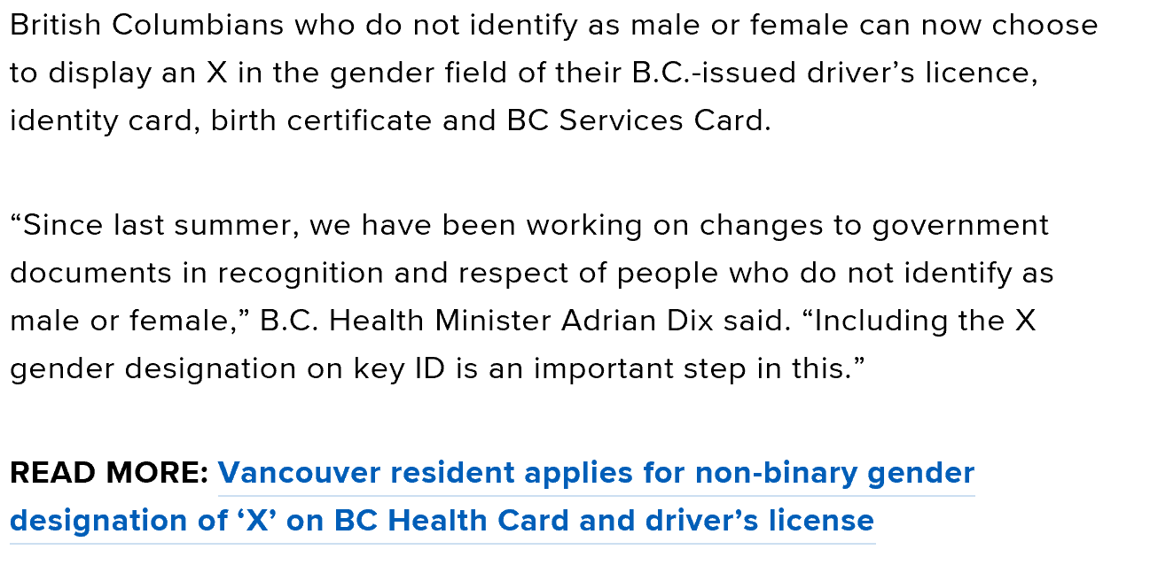
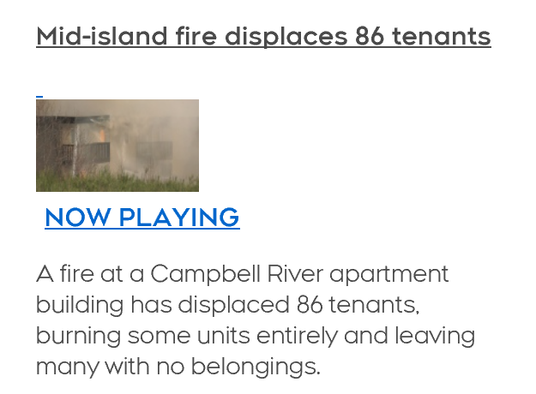
We Learned …
Complete initial enrollment in an affordable and publicly acceptable way
Name Mismatch
Gender
Vulnerable people

Slide 11
Our Identity Assets
Data for 4.75M identities
Privacy by design
In-person renewal cycle established
High assurance credential
Identity assurance service
Security
Provincial Identity Program
Mobile technology
Key enabler of digital government

Slide 12
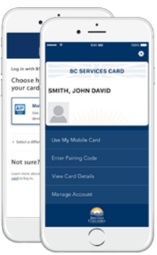
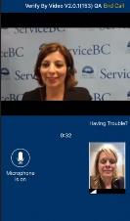


How it works: Online
Online: Mobile phone and 2nd factor
Enabling Verify by Video (live or send video)
Device fingerprint
or
Phone passcode
Digital Identity Verification
We cannot compromise the integrity of initial enrollment as we activate digital services

Slide 13
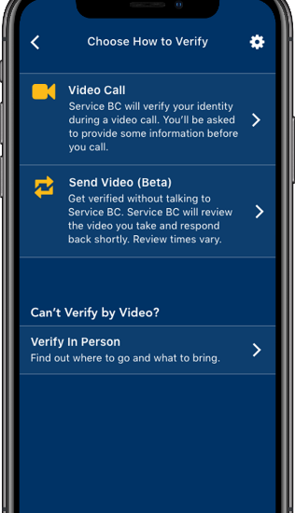
Demo - Verify by Video Citizen setting up mobile card using live video option

Slide 14

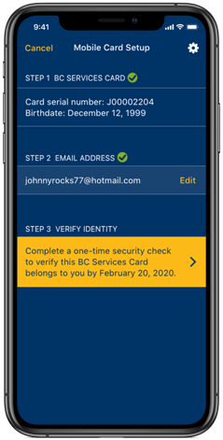

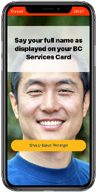
Demo
Citizen setting up mobile card with send video option

Slide 15


Goals:
CITZ is at a pivotal moment,
poised to unlock the true value of a trusted, secure, and digitally enabled identity program – the kind of transformation that was originally envisioned.

Slide 16

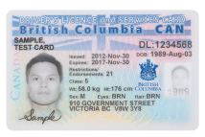
Our Digital Online Services
April 3, 2018 – Advanced Education Skills and Training StudentAid BC was the first major public-facing service launch with BC Services Card
Mobile card was launched
To date 55,000 students have gone through the identity verification process and activated their card to log in to StudentAid BC to apply for funding and track their application.

Slide 17

Services
Apply for student loans
Individual
Professional
Pay for government services
Identity proof workers
and register biometrics
Access Canada Revenue Agency tax information
Workers’ consent for criminal record check including Cannabis
Access personal health records (medication history)
Physician access to CareConnect, patients’ records and waitlists
Access personal Freedom of Information (FOI) results
Health professionals enrollment and access to PharmaNet
Online Divorce Assistant
Trans trade contractors access to pay, benefits & leave system
Apply for services in the natural resource sector
Cooperatives submit annual filings
to government
School registration, transcripts and Personal Education Number (PEN)
Health professionals enroll to see medication histories and more
Register and receive support for Emergency Support Services
Submit Vehicle Inspection Reports to Vehicle Safety BC
Access Employment Insurance and Old Age Security benefits

Slide 18
BC Services Card Results
4.75M British Columbians have a BC Services Card
17 programs launched; 12 active projects in progress
118,000 citizens accessing government services using BC Services Card
Over 100,000 Verify by Video activations
93% positive citizen app store feedback about the BC Services Card online experience

Slide 19

Lessons Learned
The integrity of the processes are critically important
It’s complex
Partnerships are critical
Use existing processes
Always bring the public along
It’s a Journey…

Slide 20
Questions/Discussion

